Slide 1

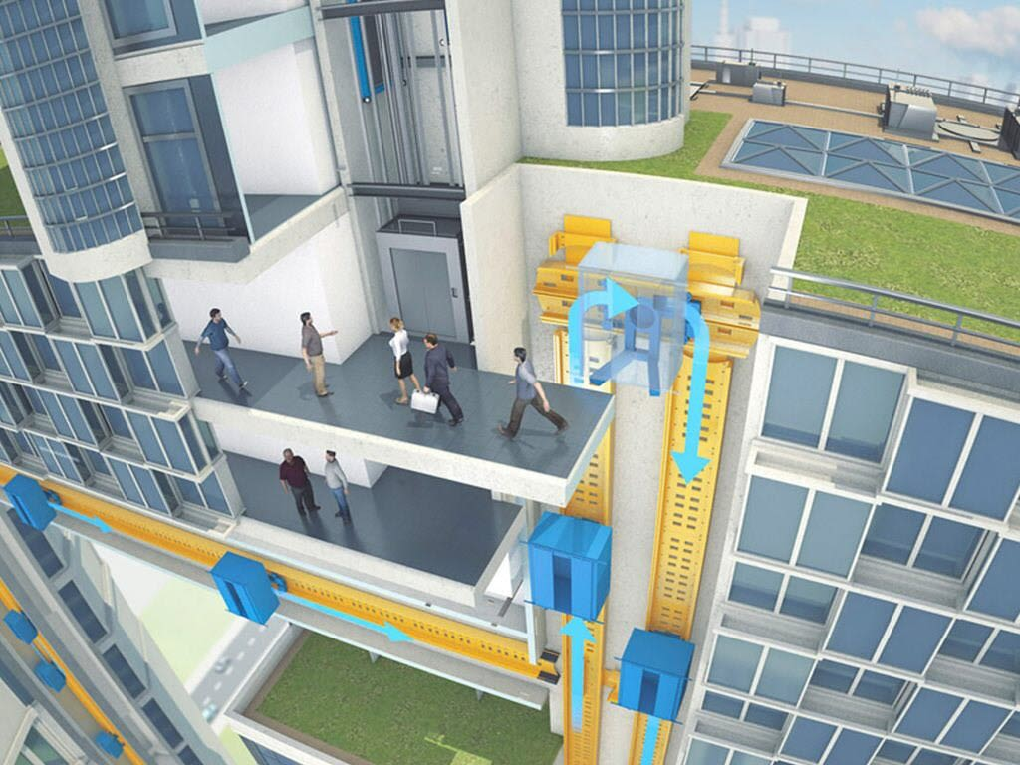


Dr
Design Real Elevator & Prototype Implementation
New Engineers Basic Training MITSUBISHI ELECTRIC

Slide 2

Project Members
Ahmed Abdelhamed
Mohamed Ashraf
Aviation Mechanics Engineer
Graduate from Zagazig University 2024
Electric Power Engineer
Graduate from Cairo University 2024
2

Slide 3
Training Benefits
Project Overview & Introduction
Traffic Analysis & Model Selection
Prototype Structure Design
Manufacturing
Testing & Results
Prototype Electronics
Outline
3

Slide 4
Training Benefits
Project Overview & Introduction
Traffic Analysis & Model Selection
Prototype Structure Design
Manufacturing
Testing & Results
Prototype Electronics
4

Slide 5
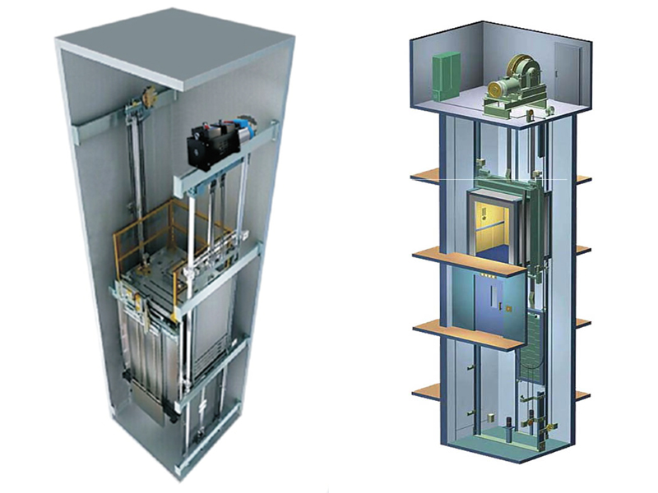
Training Benefits
Technical Skills
Elevators mechanical system.
Elevators power system and control unit.
Project management (planning & scheduling and cost study.
Safety tools.
weather factors
Coating for hull plane to avoid weather factor
5

Slide 6
Training Benefits
Soft Skills
Leadership
Decision Making
Teamwork
Time Management
6

Slide 7
Training Benefits
Project Overview & Introduction
Traffic Analysis & Model Selection
Prototype Structure Design
Manufacturing
Testing & Results
Prototype Electronics
7

Slide 8
Project Overview & Introduction
Project Objectives
Trying to design real elevator
Doing all design process
Implement prototype like real elevator
8

Slide 9
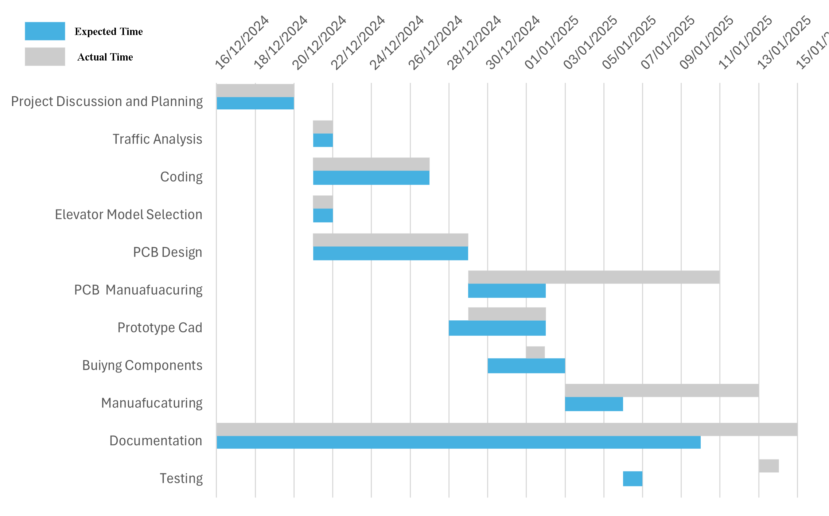
Project Overview & Introduction
Project Schedule
9

Slide 10
Project Overview & Introduction
Project Cost
Estimated Cost = 750 LE
Actual Cost = 730 LE
10

Slide 11
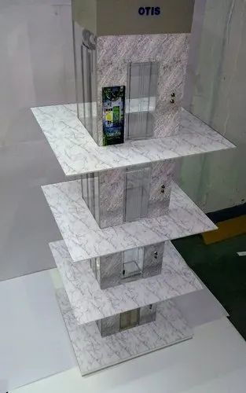
Project Overview & Introduction
Literature Review
Reading Books
YouTube search
Last Projects
11

Slide 12
Training Benefits
Project Overview & Introduction
Traffic Analysis & Model Selection
Prototype Structure Design
Manufacturing
Testing & Results
Prototype Electronics
12

Slide 13
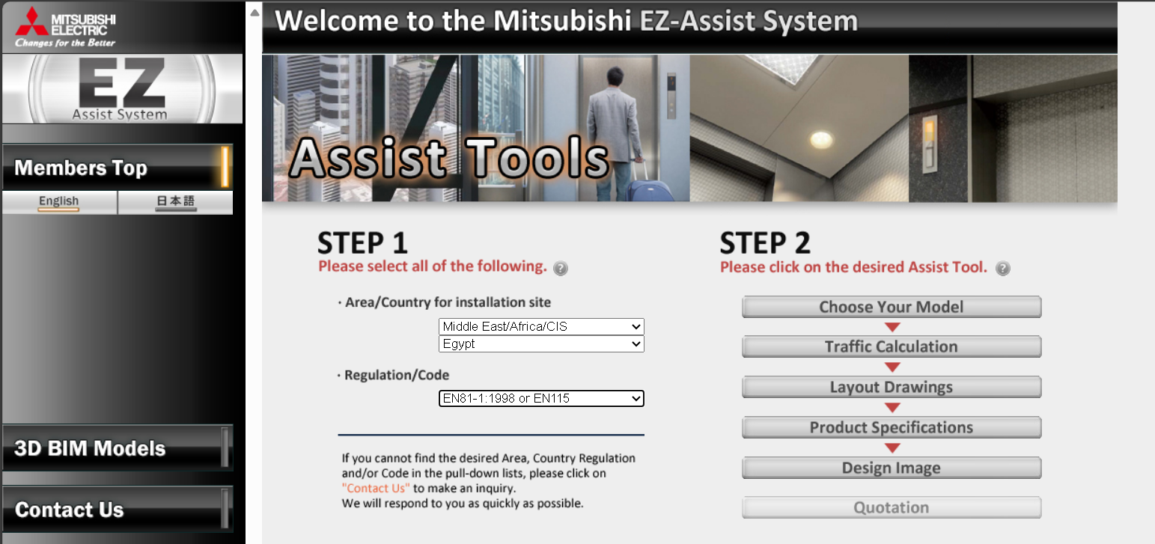
Traffic Analysis & Model Selection
Mitsubishi EZ-Assist System
Traffic calculation
Choose elevator model
Layout drawings
Product specifications
13

Slide 14
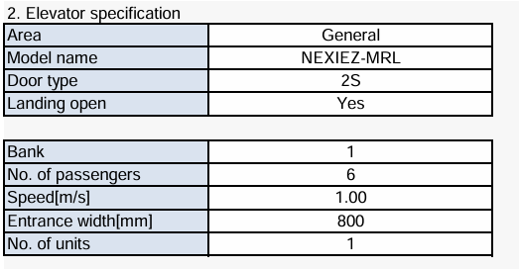
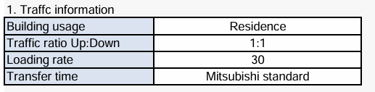
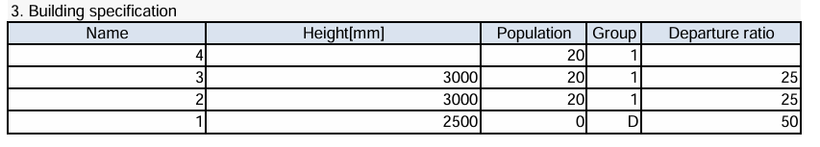
Traffic Analysis & Model Selection
Input Specifications
14

Slide 15
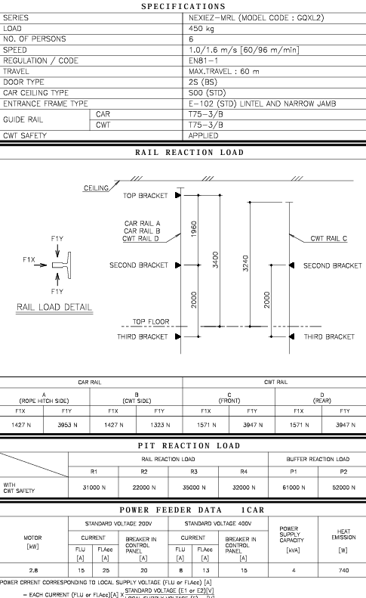
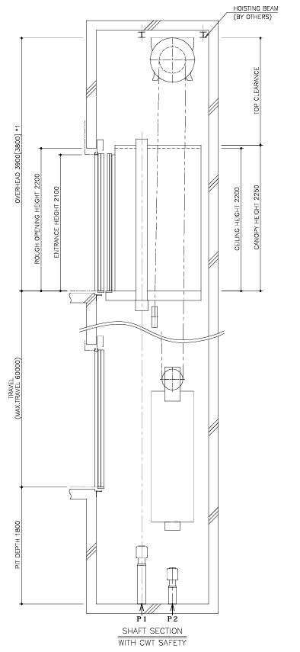
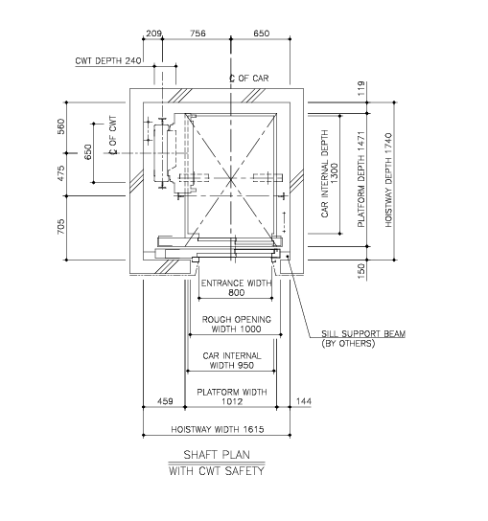
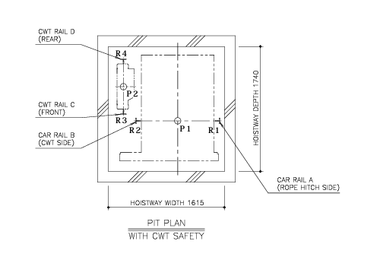
Traffic Analysis & Model Selection
Output File
15

Slide 16
Training Benefits
Project Overview & Introduction
Traffic Analysis & Model Selection
Prototype Electronics
Prototype Structure Design
Manufacturing
Testing & Results
16

Slide 17

Prototype Structure Design
Structure Material(Plywood)
Low cost
High strength
Ease of manufacturing
17

Slide 18
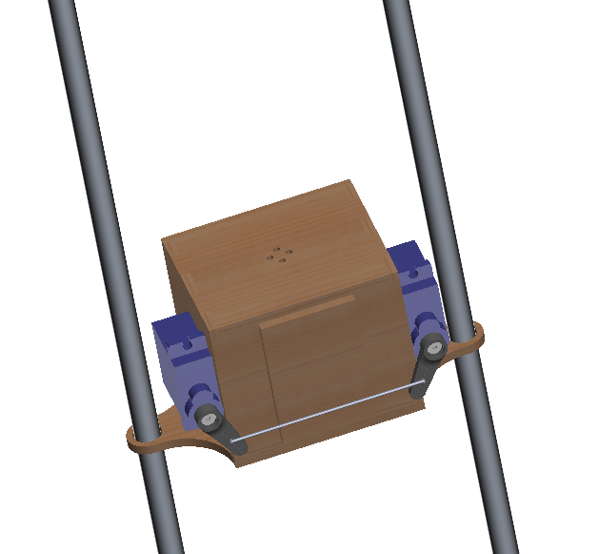
Prototype Structure Design
Cabine &CW Guide Rails(Circular Rods)
Smooth Movement
Ease of manufacturing
18

Slide 19
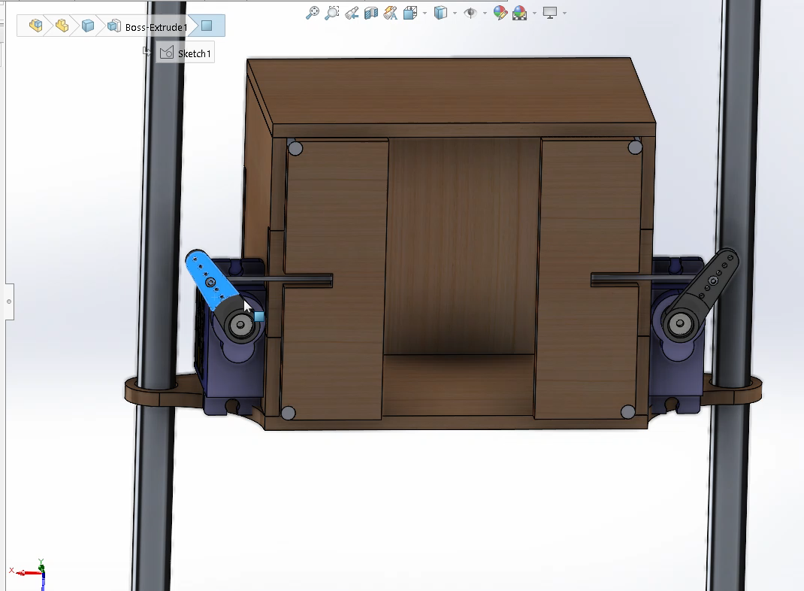
Prototype Structure Design
Cabin Door Mechanism
19

Slide 20
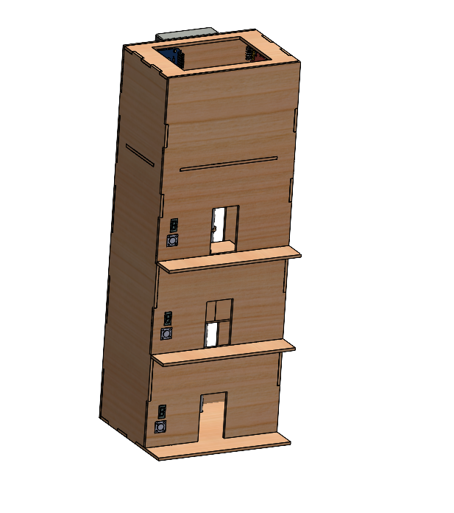
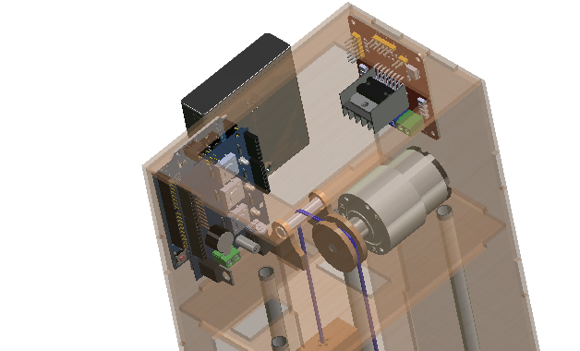
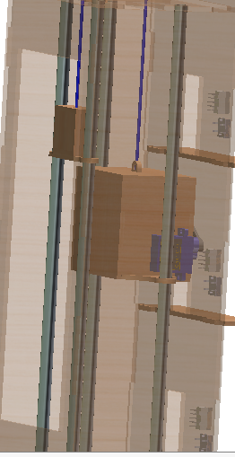
Prototype Structure Design
Final Structure
20

Slide 21
Training Benefits
Project Overview & Introduction
Traffic Analysis & Model Selection
Prototype Electronics
Prototype Structure Design
Manufacturing
Testing & Results
21

Slide 22
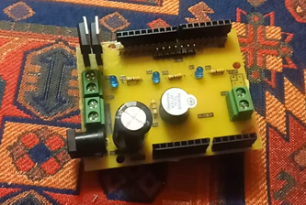
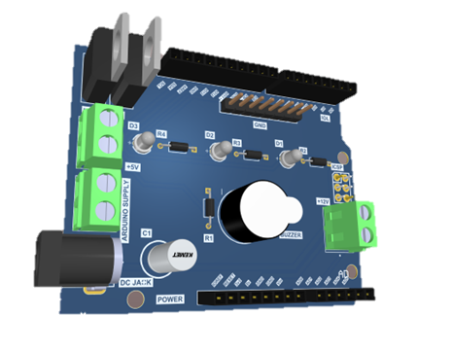
Prototype Electronics
PCB Board
Single layer PCB
Using shield technique
Robust design
Tested for malfunctions
Easily assembled
No need for wires
Printed locally & assembled manually
22

Slide 23
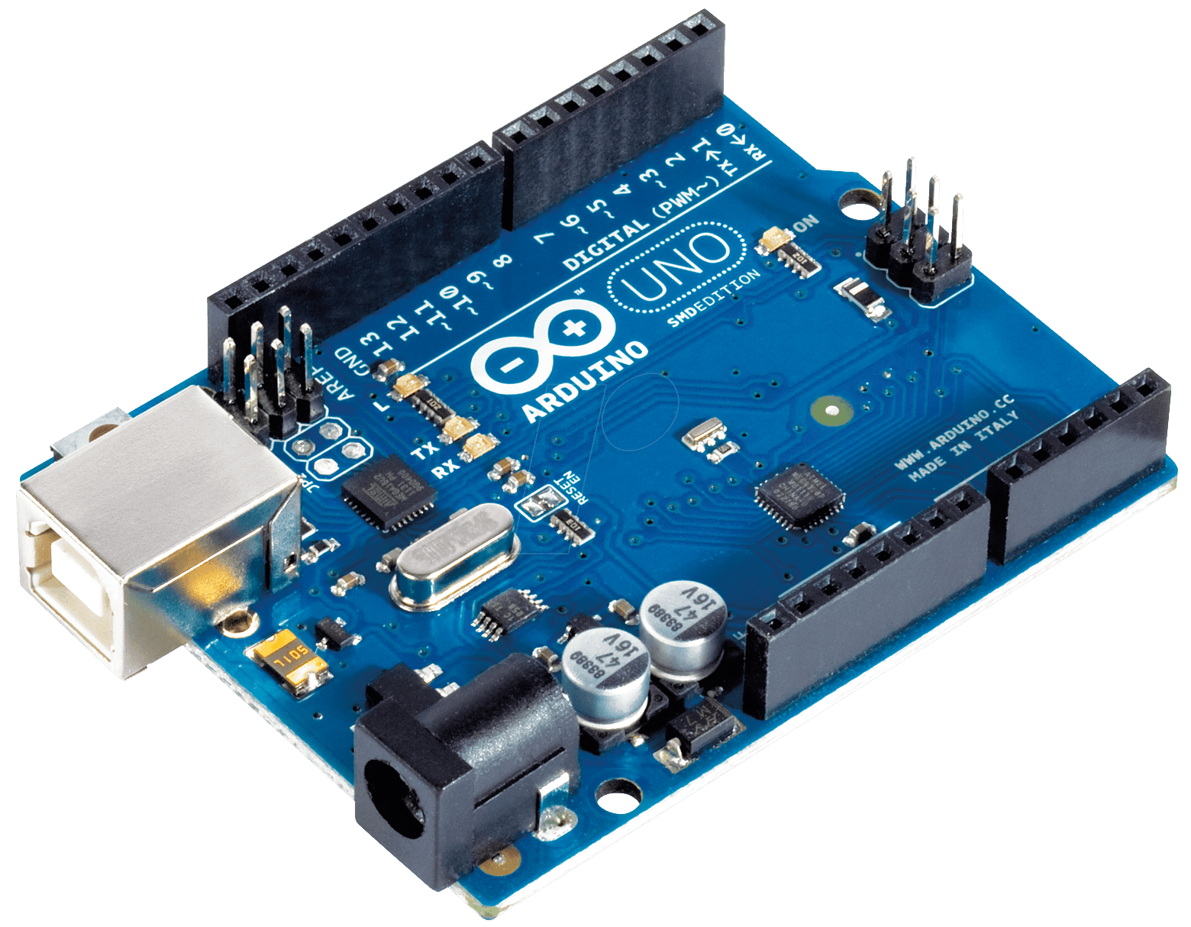
Prototype Electronics
Microprocessor (ARDUINO UNO)
Features
Cost effective
Easily programmable
Error checking capabilities
Using sensors which are available in the market
23

Slide 24
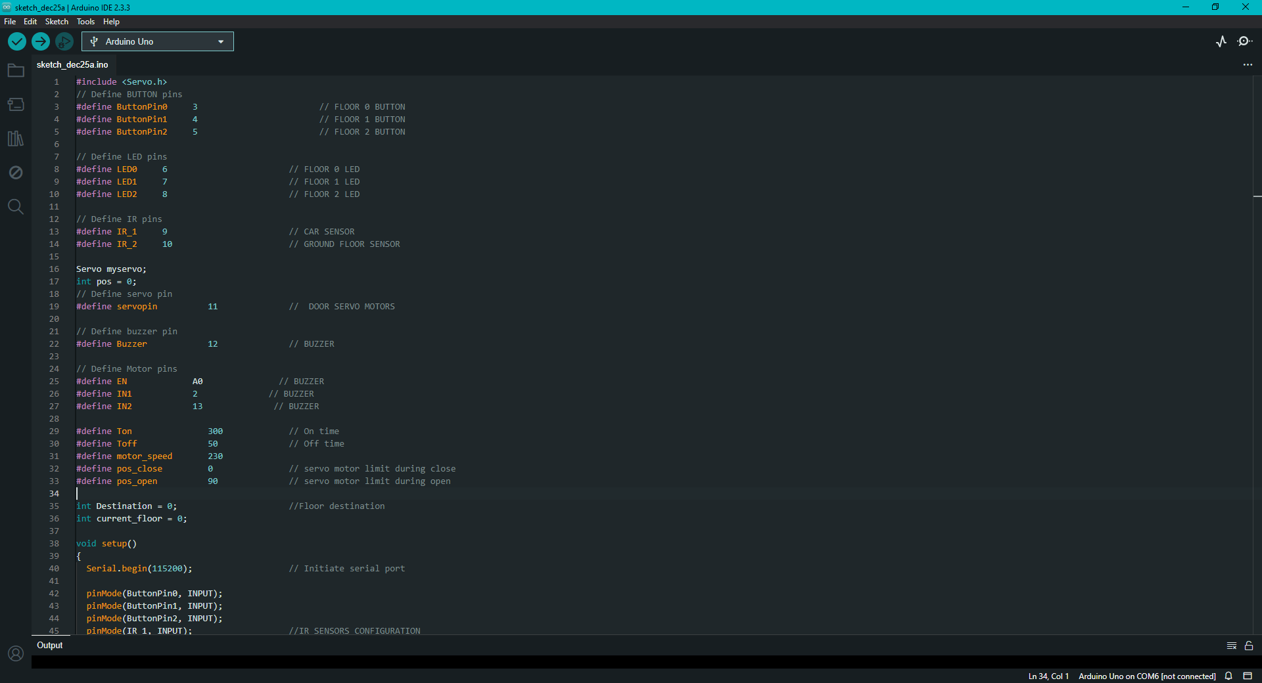
Prototype Electronics
Programming
C++ language offers relatively easy syntax and fast response
250+ lines of code
Using modular code for easy debugging and testing
The code is simulated before implemented on the hardware for error prediction
Low storage usage
24

Slide 25
Prototype Electronics
Operating Mechanism Steps
Start mechanism (Light, Ringing, Doors, DC machine)
Move to ground floor
If button is pressed, then move to corresponding floor
Wait 2 seconds for passengers to get in
Move down to ground floor
25

Slide 26
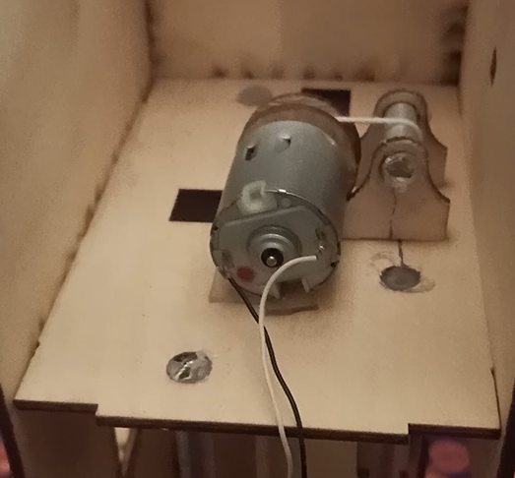
Prototype Electronics
Motor
1:1 Mounting mechanism
Speed controllable
Small size and weight
No gearbox required
Low noise or vibrations
26

Slide 27
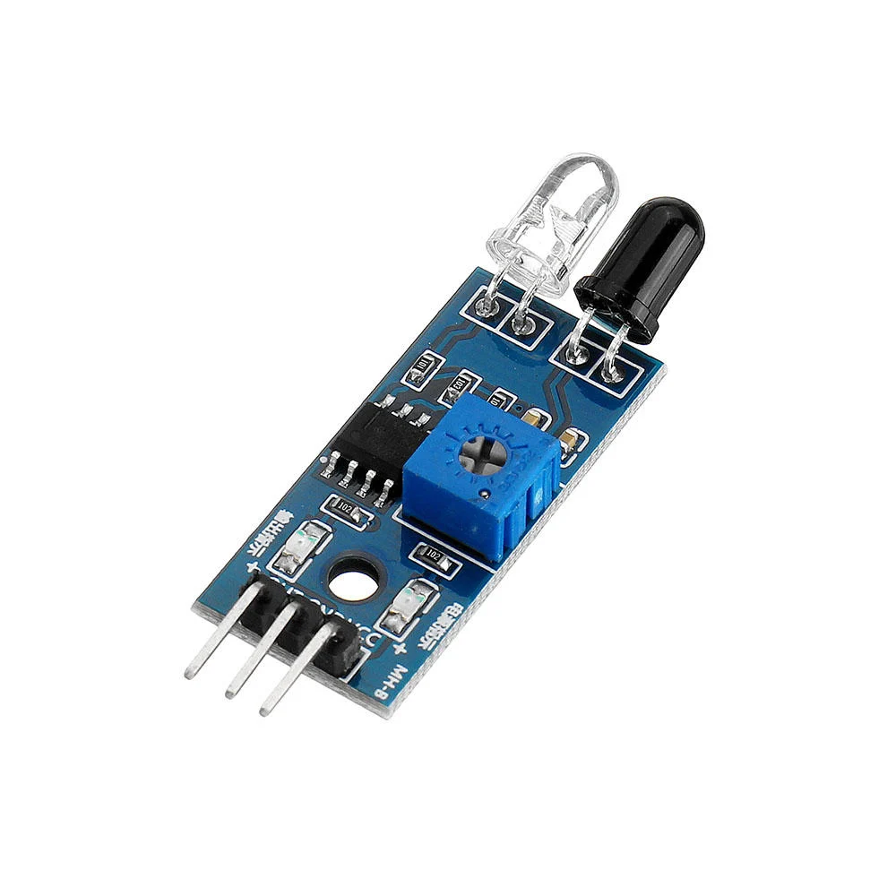
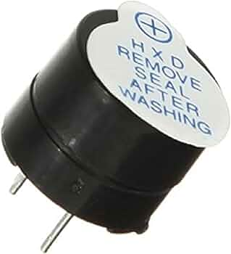
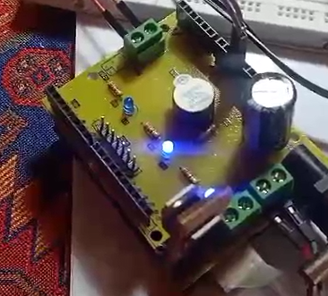
Prototype Electronics
Sensors and Actuators
Ring buzzer for alarms when closing and opening doors
Infrared sensor for car detection
LED lights for floor indication
27

Slide 28
Training Benefits
Project Overview & Introduction
Traffic Analysis & Model Selection
Prototype Electronics
Prototype Structure Design
Manufacturing
Testing & Results
28

Slide 29
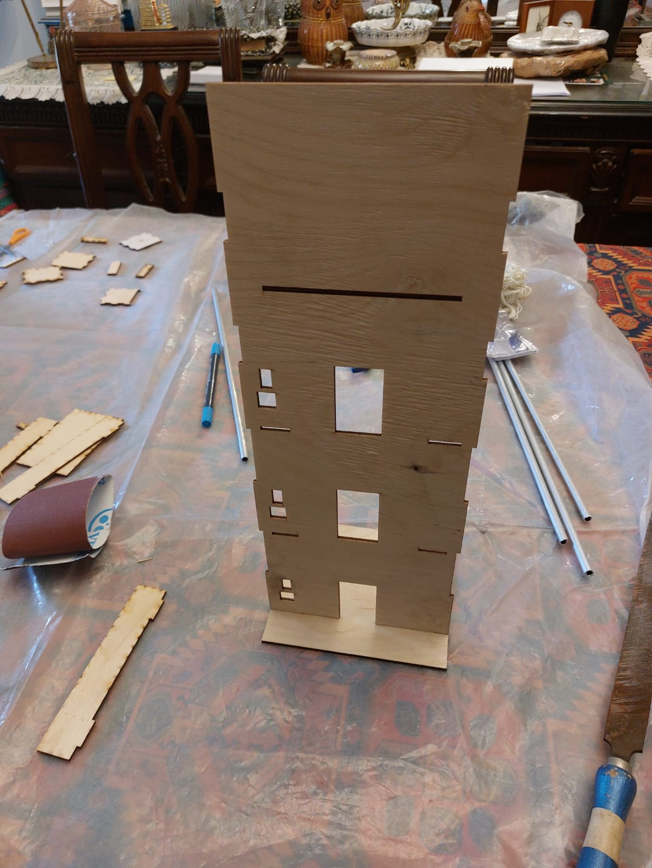
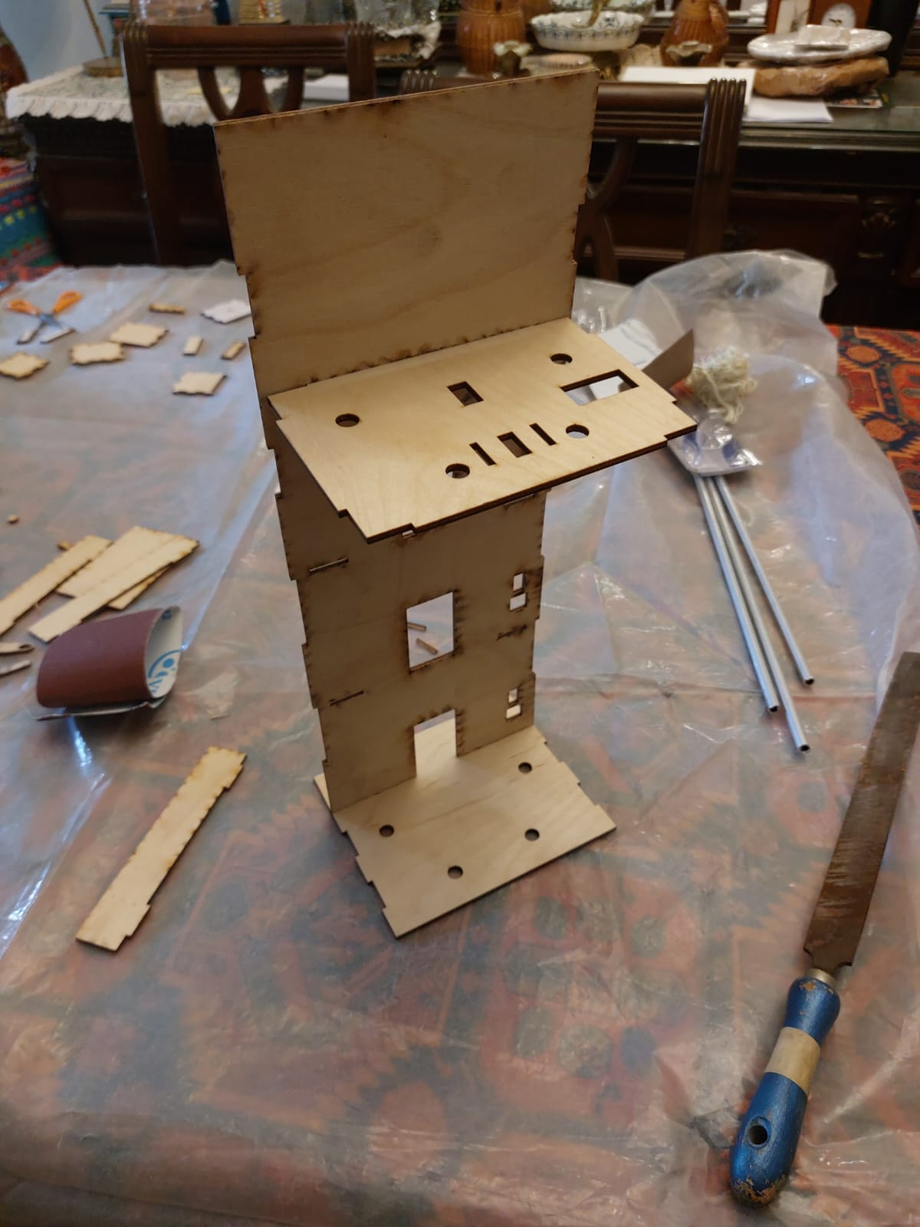
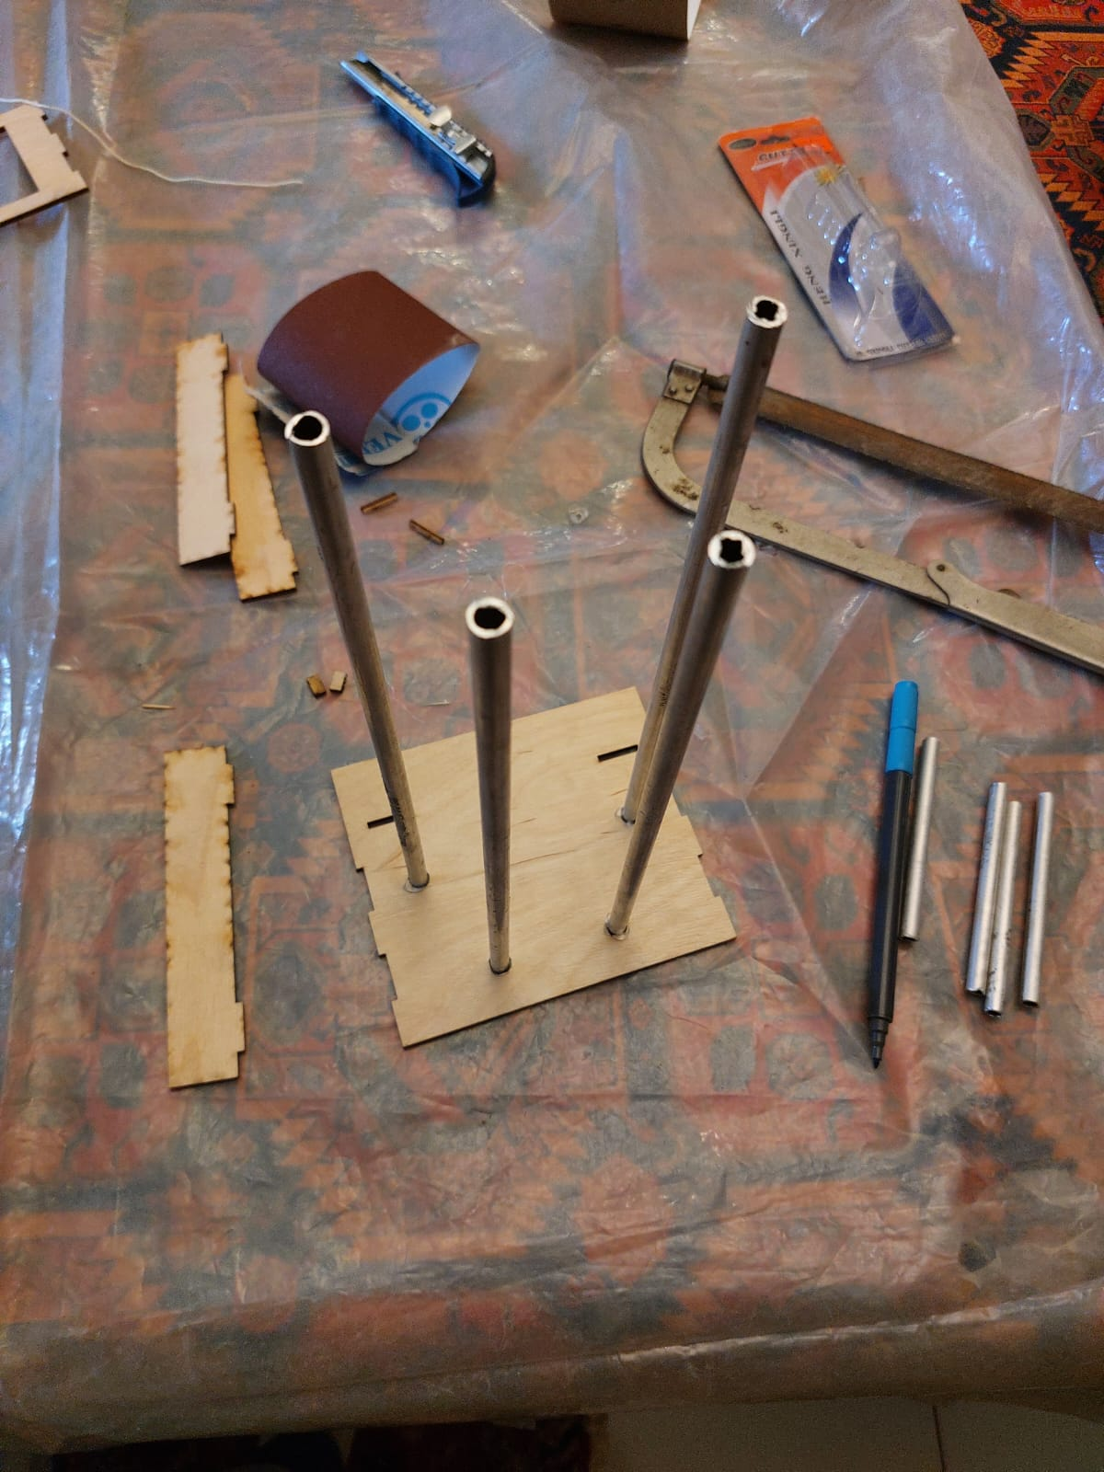
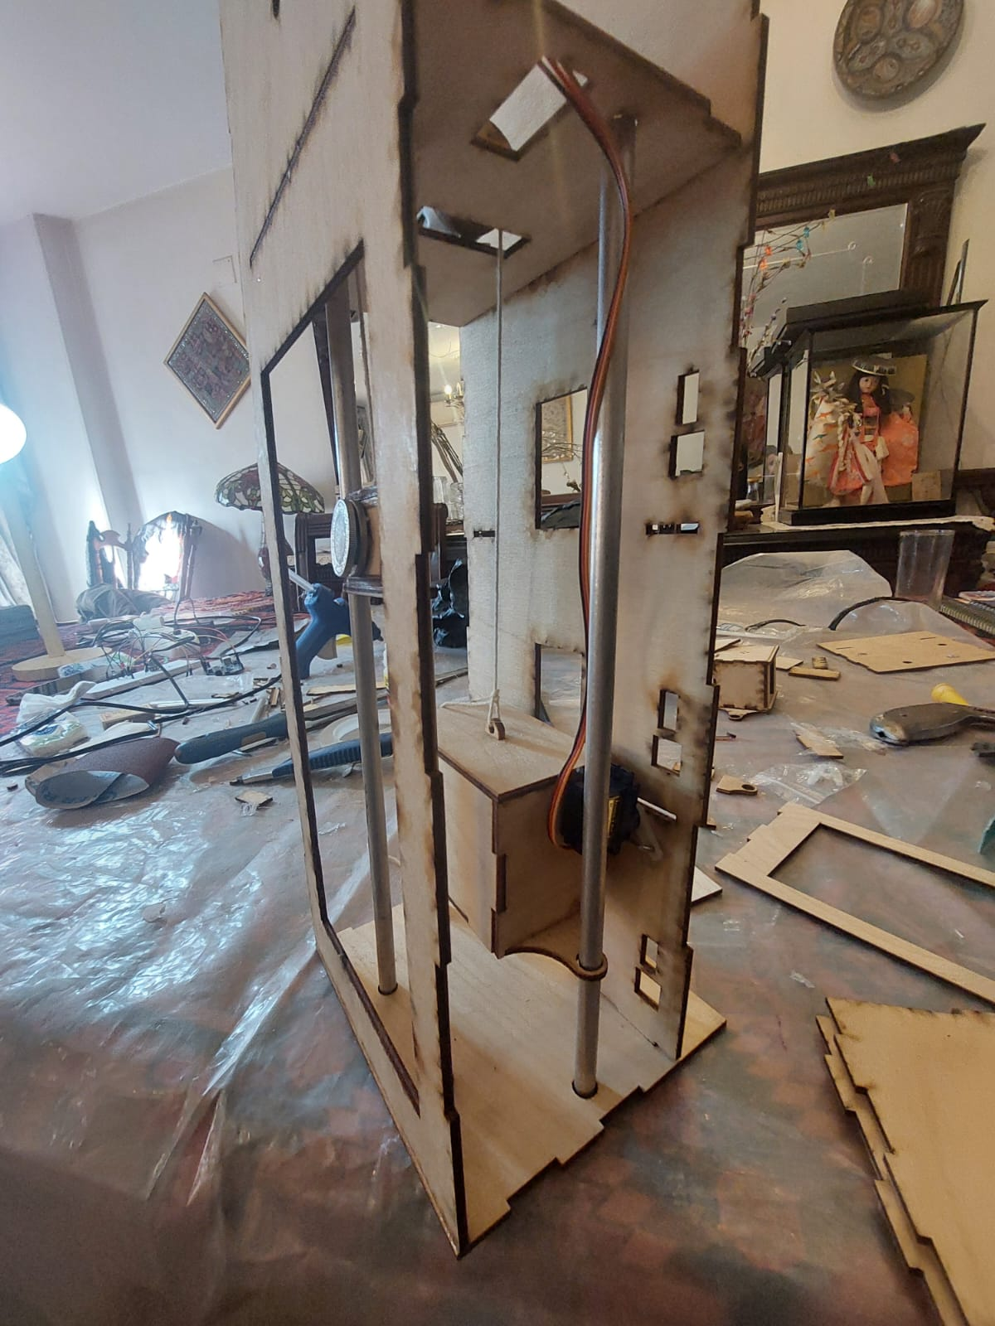
Manufacturing
29

Slide 30
Training Benefits
Project Overview & Introduction
Traffic Analysis & Model Selection
Prototype Electronics
Prototype Structure Design
Manufacturing
Testing & Results
30

Slide 31
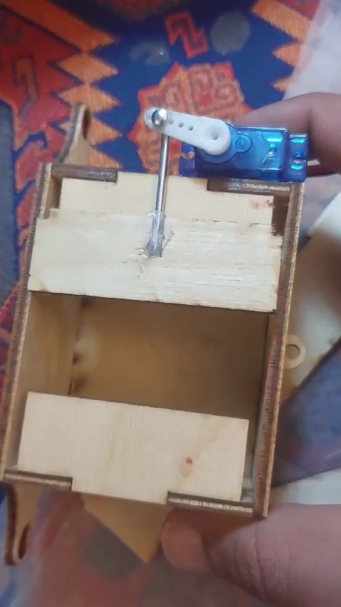
Testing & Results
Door mechanism
31

Slide 32
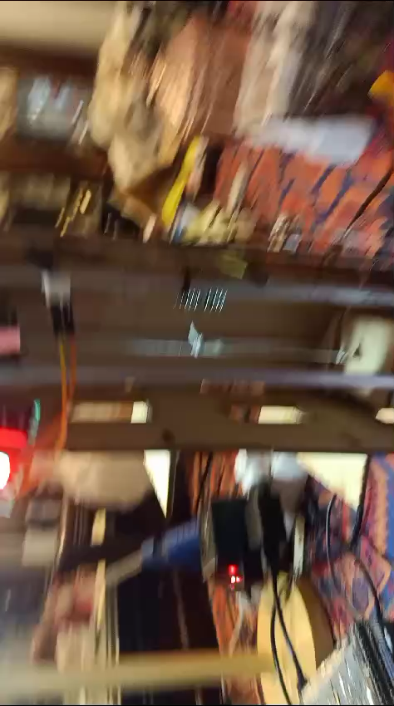
Testing & Results
Cabin & CW
32

Slide 33
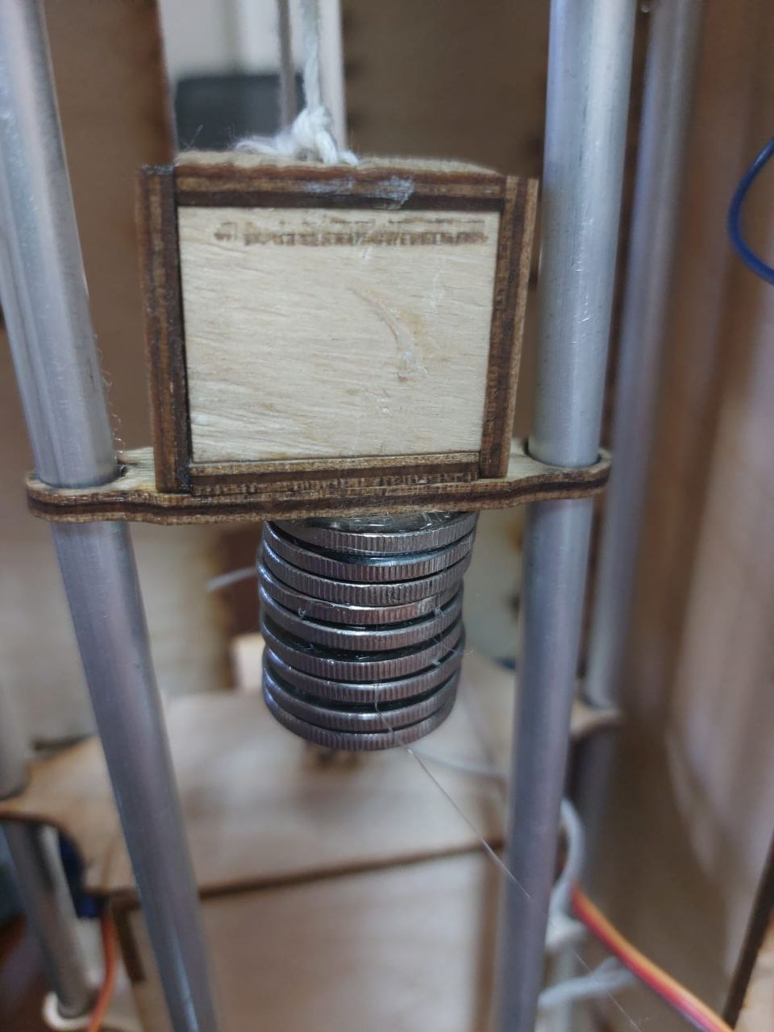
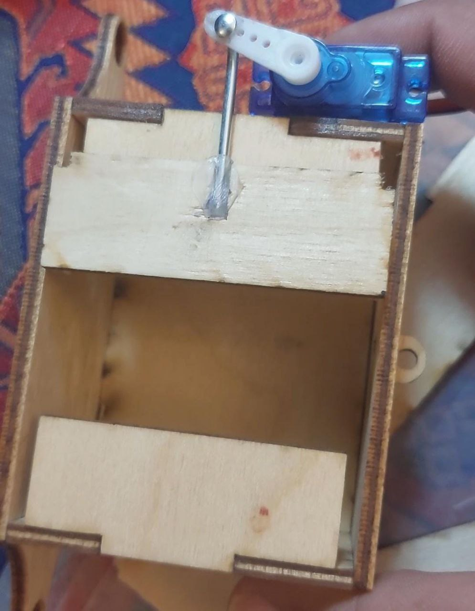
Testing & Results
Problems
Door Mechanism
Weight Balance
Guide Rail Friction
33

Slide 34
Conclusion
Work Experience
The training helped us increase our work experience
Model Selection
Select real model elevator to real application
Hardware Implementation
Increase technical skills by implementing this prototype
34

Slide 35
THANK
You for your time
We wish our project satisfied your interest.
35

